Slide 1
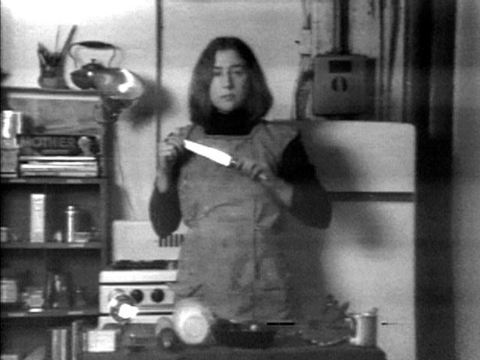
TO PREPARE REVOLUTION
Peter Sheehan

Slide 2
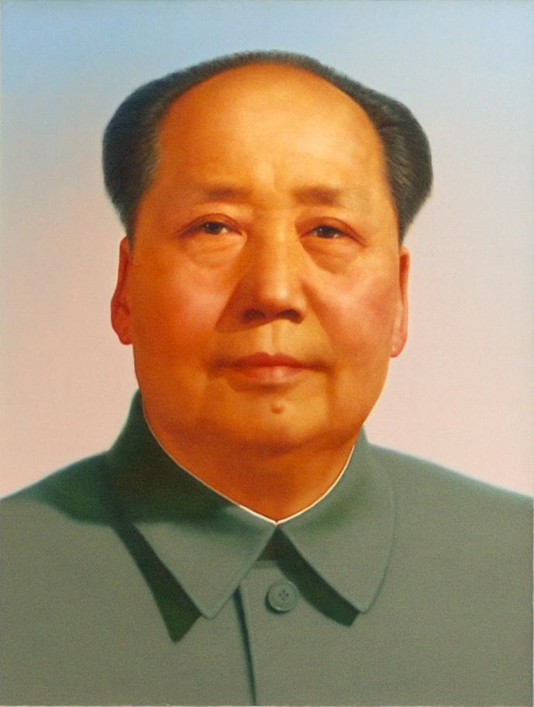
MAO
“A revolution is not a dinner party, or writing an essay, or painting a picture, or doing embroidery; it cannot be so refined, so leisurely and gentle, so temperate, kind, courteous, restrained and magnanimous. A revolution is an insurrection, an act of violence by which one class overthrows another.”
Notes:
To start with, I want to define what a revolution is, and here we have Mao, probably one of the most if not the most important revolutionary of the 20th century, if not one of the most controversial. Considering the extremeness which Mao was willing to go for the revolution, to commit decisive acts that had far reaching consequences, what does he have to say about revolution? In this quote, the foremost revolutionary dismisses art as being a generous activity. In a sense, he is saying that art, social events, relational aesthetics, are a signifier for revolution, without actually being a revolution. A revolution, he says is an actual insurrection, an actual act of violence in which one class overthrows another.

Slide 3
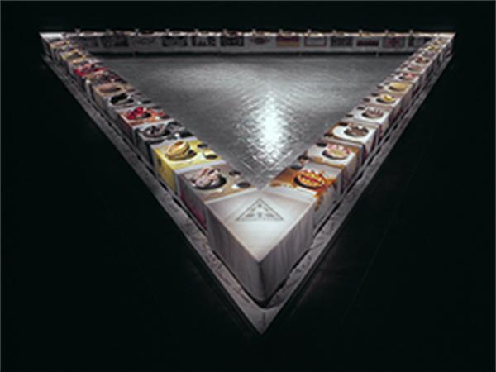
THE DINNER PARTY
Judy Chicago: “I firmly believe that if art speaks clearly about something relevant to people’s lives, it can change the way they perceive reality.”
Notes:
So how do we adress works like this one? Judy Chicago’s The Dinner Party has extremely high demands for itself. It took 6 years and tens of thousands of dollars to produce, with over 125 collaborators, though there are far less than that who were consistent collaborators. The work involved huge technical problems like figuring out jiggering, carving plates, needlework. The piece itself is about these techniques, and their development by women which has historically been in the service of men or domesticity. Chicago wanted to make a work that would expose these histories. Judy Chicago ran into issues with funding, with coordination, with needing other people to do the work she couldn’t do, with exhaustion, with her own star power. Often times, she says that the project is more important than her happiness, though she feels insecure about it being what she wants it to be: a masterpiece.
Not only does she want to make a masterpiece. On page 39, Chicago says that “if feminist art education is to develop as a viable alternative tool, I will probably have to train people here in the studio an then send them out in the world.
To Chicago, the art work itself is about several things: The enormity of the task of changing attitudes on a large scale; the problems of female role conditioning and how it prevents women from working at all, much less facing the challenge of changing their condition, and the absence of support in society. These were also problems she had to deal with while making the massively epic work.

Slide 4
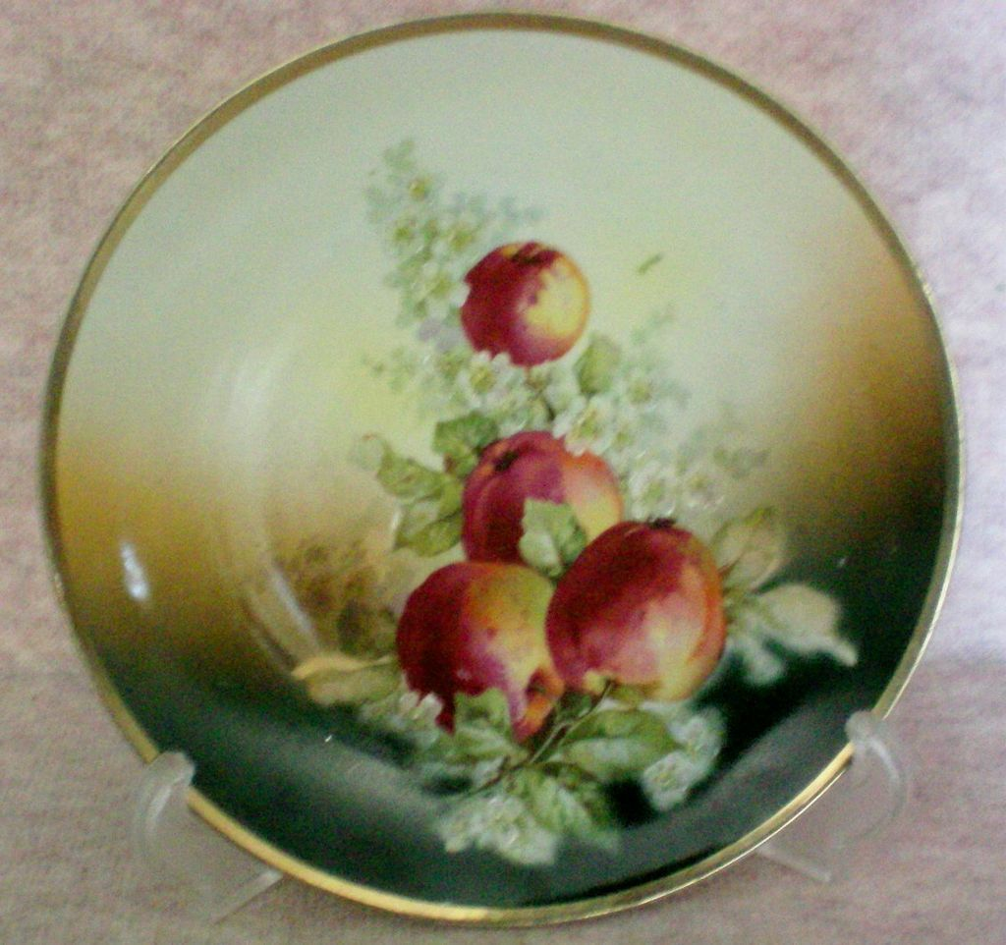
WHY THE DINNER PARTY
“This woman had done all the work, trying as best she could to fit her creative drive— which could probably have expanded into mural size paintings or monumental sculptures- into the confined space of her house, which could hardly have held another piece of WORK. The china painting world and the household objects the women painted, seemed to be a perfect metaphor for women’s domesticated and trivialized circumstances.”
Notes:
Yet to think about the reasons why, Chicago says in her book “The Dinner Party: A Symbol of Our Heritage” that the Dinner Party is really how society has manipulated women into directing their creative energies and potentials into housework, trivializing them. Chicago wants more women to make epic work, and so she sets an example with the Dinner Party.

Slide 5
MONUMENTAL ART
As a symbol of heritage, what makes the dinner party more than ascribing to the character of a monument? Judy Chicago wants the piece to be a masterpiece. I would argue she makes it a monument, which are similar, but distinct. A monument requires an institution behind it. Art does not necessarily need one.
“I would say, one crosses the threshold of the logic of the monument, entering the space of what could be called its negative condition-a kind of sitelessness, or homelessness, an absolute loss of place. Which is to say one enters modernism, since it is the modernist period of sculptural production that operates in relation to this loss of site, producing the monument as abstraction, the monument as pure marker or base, functionally placeless and largely self-referential. “ - Rosalind Krauss, Sculpture in the Expanded Field
Notes:
First shown at San Francisco Museum of Modern Art

Slide 6
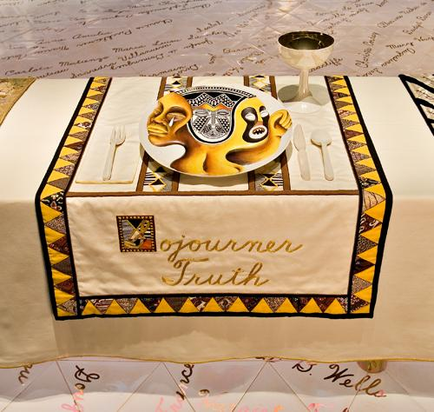
CRITICISM
Exclusionary, inherently a Western focused piece focused on white women
Did not pay her workers, took advantage of their commitment to the project (in my opinion)
Notes:
First shown at SFMOMA
Did not pay workers
or perhaps overreaction—to the traditionalstereotype of Black women as oversexed.Chicago does include the names of other Black women among the 999 names on thefloor tiles, but this roster is still dominated by white women of European background.The only First Nations woman at the table is Sacajawea, again a collaborator with white—and, this time, colonial—interests. Although the goddesses represented at the tableare multi-cultural, the actual historical guests do not include any Latinas or Asianwomen.

Slide 7
THESIS
The central theme of this presentation is the difference between large scale multi year work and shorter form performances, with similar goals in mind— to express anger and frustration with the historical treatment and social role of women in society serving primarily as laborers and second class citizens. How does the methodology of antagonism affect the art world, changing from ideas of masterpieces and great works to including those outside of the domain?
Notes:
The central theme of this presentation is the difference between large scale multi year work and shorter form performances, with similar goals in mind— to express anger and frustration with the historical treatment and social role of women in society serving primarily as laborers and second class citizens. How does the methodology of antagonism affect the art world, changing from ideas of masterpieces and great works to including those outside of the domain.

Slide 8

RELATIONAL AESTHETICS
Relational Aesthetics is a theory of form, not of art. Relational aesthetics was supposed to be a democratization of art, a form of art whose chief goal was to get dialogue between people going.
Claire Bishop develops antagonism through
Laclau and Moffe
Notes:
Relational Aesthetics is a theory of form, not of art. It deals primarily with the art of the 1990s. It is developed by Nicholas Bouriaud in an attempt to drum up support for pieces he was curating at the time, which involved interaction and the promotion of dialogue. Relational aesthetics was supposed to be a democratization of art, a form of art whose chief goal was to get dialogue between people going. The problem was that in the context of galleries these social situations were more applicable to meeting at a trendy bar than anything revolutionary. Claire Bishop talks about this in her piece on relational aesthetics, Antagonism and Relational Aesthetics, where she theorizes about something discussed in prior books - antagonism.
In relational aesthetics: “art is exceeded by a revolution in day-to-day life.” Guy Debord

Slide 9
ANTAGONISM
Who is the revolution for? This may be a microtopia, but—like utopia—it is still predicated on the exclusion of those who hinder or prevent its realization.
The relations produced by their performances and installations are marked by sensations of unease and discomfort rather than belonging, because the work acknowledges the impossibility of a “microtopia” and instead sustains a tension among viewers, participants, and context. (Bishop 70)
Notes:
Antagonism is an attempt to make the viewer feel uncomfortable with themselves, by highlighting the other in a piece. Rather than make a work which aims to be the utopia most art envisions for the future in the present, antagonistic art attempts to instill unease and discomfort in and between its viewers, participants and the institution it sets itself up in.

Slide 10
CAPITALISM AND INVISIBILITY
Traditional women’s roles are “invisible work” or labor that is widespread throughout society and yet not conceived as work and moreover, not valued.
$
Notes:
This is what the work I’m talking about today is fighting against - the exploitation of women by traditional societies, and its being leveraged by capitalism for profit, whether that be in the production of cooking items, tv shows, and in the promotion of art and culture which best maintains its markets. This is why the Dinner Party, as indicated by Chicago, took so long and was met with so much difficulty - the system is against the topics its dealing with, and it would ruin massive businesses if its goals of women’s liberation were met.

Slide 11
HOW HAVE ARTISTS ATTEMPTED TO MAKE CHANGE?
Labor is an essential theme to the chosen works.
They use that which is contemporary - the internet, film, photography, television, to get their points across.

Slide 12
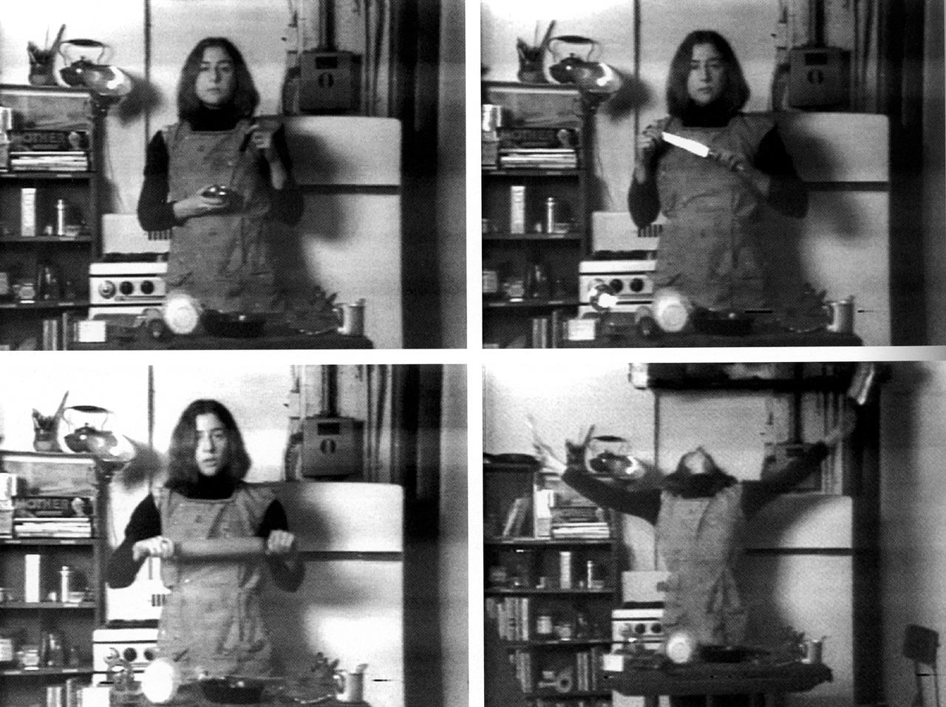
SEMIOTICS OF THE KITCHEN
Martha Rosler embraces film to transform the distribution of art through technology in Semiotics of the Kitchen. The medium serves both as a parody of cooking shows, which are essentially designed to be propaganda which reinforce domestic roles.

Slide 13
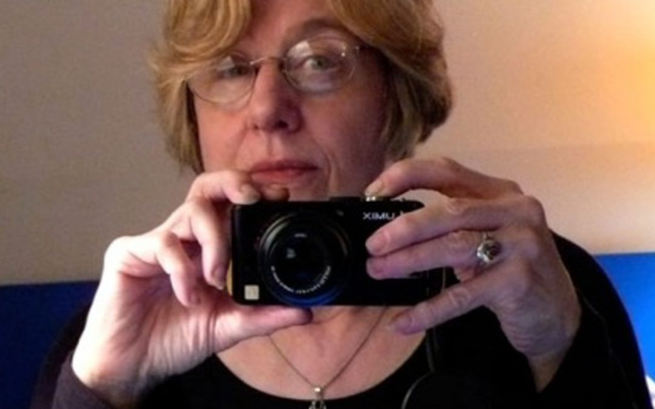
SHEDDING THE UTOPIAN
“Regardless of the intentions (which were heterogeneous) of artists who turned to television technologies… many of these early users saw themselves as carrying out an act of profound social criticism, criticism specifically directed at the domination of groups and individuals epitomized by broadcast tv and perhaps all of mainstream Western industrial and technological culture.” - Martha Rosler

Slide 14
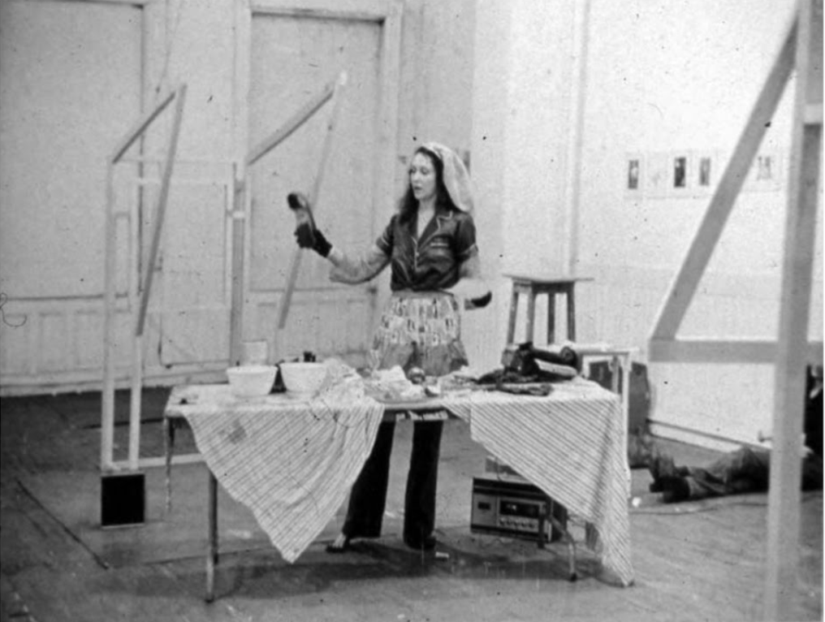
I CHING APPLE PIE
I Ching Apple pie by Carolee Schneemann, like Semiotics of the Kitchen, incorporates domestic tools in a critique of patriarchal dominance.

Slide 15
FROM THE LIBERATED COOKBOOK
Go into the kitchen with defiant joyful anger. On this scruffy battleground you will lay down the cookbook forever. You will cease competition with untold legions of sublimated self-satisfied female psyches engaged over the centuries. In a pursuit of excellence through flour grease onion turnips blenders colander strainer boilers mincers graters choppers whiskers mincers beaters DESIST DESIST STOP STOP NOW

Slide 16
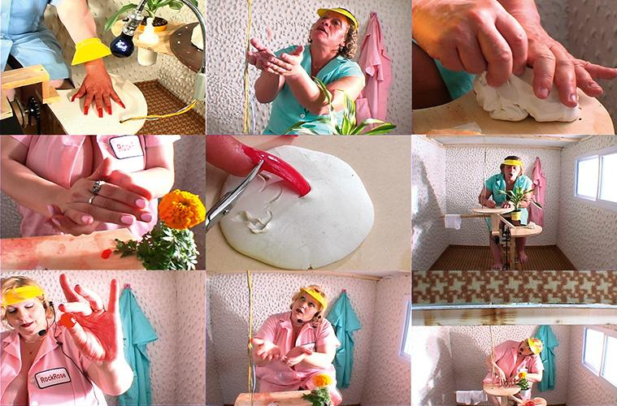
MARY’S CHERRIES
Mary’s Cherries imagines a capitalist structure that seems utopic— the grow light will grow the fingernails always, which is powered by the women, and generates a dessert that can be sold for burgers, apparently.
Notes:
http://ubu.com/film/rottenberg_cherries.html

Slide 17


MARY’S CHERRIES
Mika Rottenberg hired “fantasy wrestlers” for this work, outsiders to the art world. These are women who will beat men in wrestling matches, to then be paid for their services.

Slide 18
ANTAGONISM REVISITED
An integral part of the tension of antagonism is the introduction of collaborators from diverse economic backgrounds, which in turn serves to challenge contemporary art’s self-perception as a domain that embraces other social and political structures.

Slide 19
TO CONCLUDE
The fact is, these works are attempts to promote revolution. The question remains how well they themselves get the job done. They use their institutions to attempt to deal with issues of economic and political exploitation, yet they would be ineffective as revolutionary tools without the lens of antagonism.

